Slide 1
Client – Server Architecture
Prof Ashish Paliwal

Slide 2
Network
A Computer Network, often simply referred to as a network, is a collection of hardware components and computers interconnected by communication channels (either wired or wireless) that allow sharing of resources and information. This means that the computers can "talk" to each other and that every computer in the network can send information to the others.
Computers can be part of several different networks. Networks can also be parts of bigger networks.
The connection can be done as peer-to-peer or client/server.

Slide 3
Client Server Architecture
A network architecture in which each computer or process on the network is either a client or a server.

Slide 4
Components
Clients
Servers
Communication channel / Networks
Server
Client

Slide 5
Client
Client
Server

Slide 6
Part of the rationale
Specialization:
Clients specialize in user interface
Servers specialize in managing data and application logic
Sharing:
Many clients can be supported by few servers
Often data and logic are shared among applications and users

Slide 7
“I want to
collaborate
with my
colleague”
“I want to access
some information”
Client
Server
Peer-to-peer
Client/server

Slide 8
Clients
Applications that run on computers
Rely on servers for
Files
Devices
Processing power
Example: E-mail client
An application that enables you to send and receive e-mail
Clients are Applications

Slide 9
Servers
Computers or processes that manage network resources
Disk drives (file servers)
Printers (print servers)
Network traffic (network servers)
Example: Database Server
A computer system that processes database queries
Servers Manage Resources

Slide 10
Distinctions
Client-server
Asymmetric relationship ( Asymmetric networks, on the other hand, support disproportionately more bandwidth in one direction than the other )
Client predominately makes requests, server makes replies
Peer-to-peer
Symmetric relationship ( In a symmetric computer network, all devices can transmit and receive data at equal rates )

Slide 11
Email application
Server
Client
Client
Email client sends message to server
Later, recipient’s email client retrieves message from server
Message is stored on POP server

Slide 12
Chat application
Server
Client
Client
Chat server aggregates typing from all users and sends to all clients
Other user’s clients display aggregated typing from chat server
Chat clients send user’s typing to server

Slide 13
Communication Networks
Networks Connect Clients and Servers

Slide 14
Application Components
3
Data Management
Types of Clients
2
Application Logic
Fat
Client
1
Presentation
Thin
Client
3 Logical Tiers
Database Applications:
Most common use of client-server architectures

Slide 15
Three-tier client/server
Local-area network
Application
logic
Presentation
Note: many clients per
application server, several
application servers per data server
Shared
data

Slide 16
Client–Server Computing
Process takes place
on the server and
on the client
Servers
Store and protect data
Process requests from clients
Clients
Make requests
Format data on the desktop
Client-Server Computing Optimizes Computing Resources

Slide 17
Application Functions
Software application functions are separated into three distinct parts
Server:
Data Management
Client: Presentation & Application Logic

Slide 18
Middleware
Software that connects two otherwise separate applications
Example: Middleware product linking a database system to a Web server
Database Server:
Manages Data
Middleware Links Applications
Web Server:
Presents Dynamic Pages
Client: Requests Data via Web

Slide 19
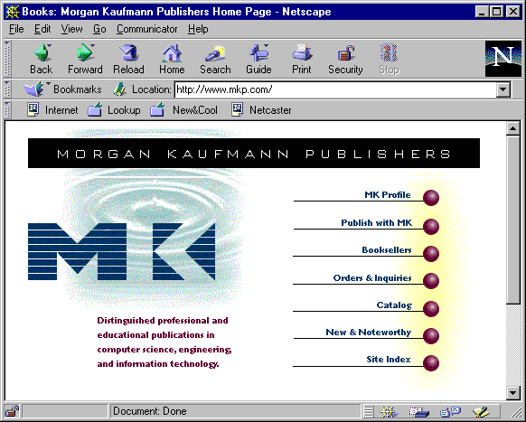
Client
Host architecture
Web
browser
Web
server
Common
gateway
interchange
Application logic
Databases and DBMS
Application partition

Slide 20
Customers
Customer-service
department
Technical-support
department
Consumer
Enterprise

Slide 21
Consumer
application
Enterprise
application
Web
browser
Web
browser
Web
browser
Web server
Web server
Web server
Customer care
Customer logic
Agent logic
Technician logic
Databases
Customer
audit
Software
documentation
Problem
knowledge
base

Slide 22
Customers
Agents
Technicians
Customer logic
Agent logic
Technician logic
Databases
Accounts
Products
Orders

Slide 23
Information providers
Customers
Stock market
Consumer
Enterprise
Inter-enterprise

Slide 24
Clients
Information
providers
Customer logic
Trading logic
Databases
Financial
markets
Accounts
Products
Orders

Slide 25
Types of Servers
From A to Z
Application Servers
Audio/Video Servers
Chat Servers
Fax Servers
FTP Servers
Groupware Servers
IRC Servers
List Servers
Mail Servers
News Servers
Proxy Servers
Telnet Servers
Web Servers
Z39.50 Servers
Source: http://webopedia.lycos.com

Slide 26
Thank You

